Slide 1
Corona travel
Detailed design

Slide 2
Product description
Our goal is to allow users to travel online from home via any device of their liking. They'll start by opening an app or a link and choosing a desired destination. After choosing a location, users can choose to view destination in 3D, look at some 3D photos or videos or learn some facts about the place.
Team: Sofya Donskaya, system analyst; Elena Karelina, backend developer; Danil Kireev, frontend developer; Artem Filimonov, backend developer + API integrator
Repo: https://github.com/randomunrandom/corona_travel
Report: https://docs.google.com/presentation/d/19lmSKnWol770kLv_CnQwMoJ-xcEiRje0MoZKP1R9pPU/edit?usp=sharing

Slide 3
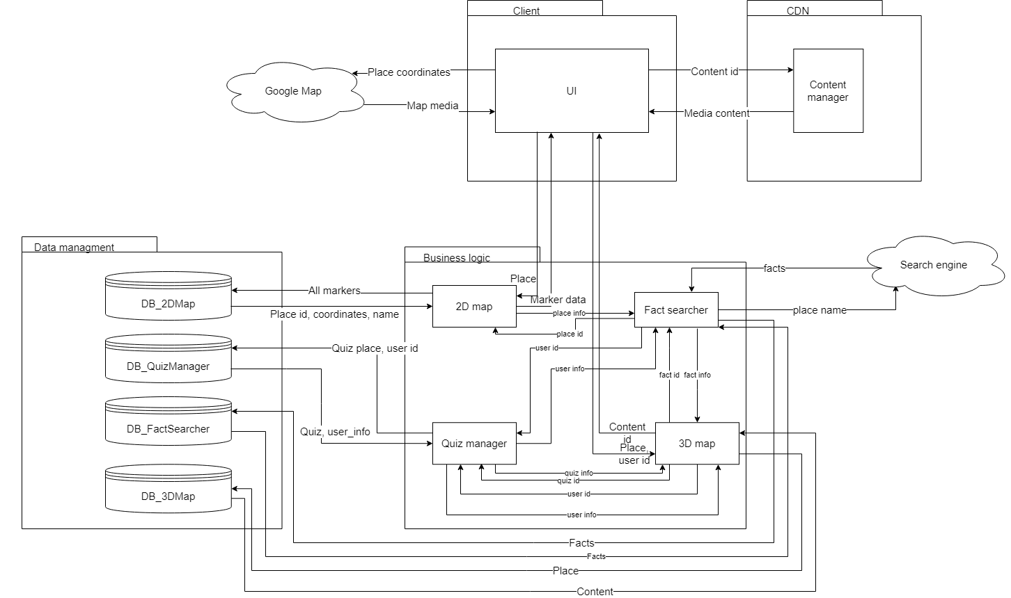
System architecture
Most important principles within our architecture:
Simplicity
Separation of concerns
Don't Repeat Yourself (DRY)
Easy to extend
Weak bounds

Slide 4
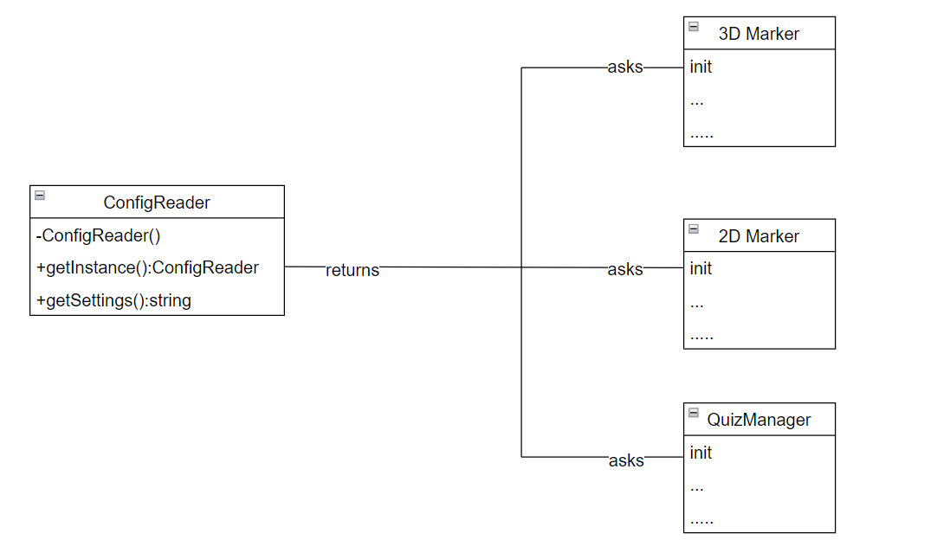
Design case <1> (UML2)
Problem: don’t read settings file multiple times because using file settings is slow
Solution: the class responsible for reading file with settings should be created only once and read file at creation. Use singleton
Notes:
Соня

Slide 5
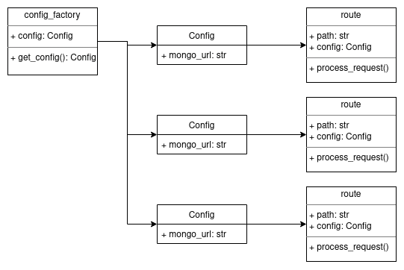
Design case <2> (UML2)
Problem: get settings in routes as dependency to process routes asynchronously
Solution: use factory to create the same config for every route
Notes:
Данил

Slide 6
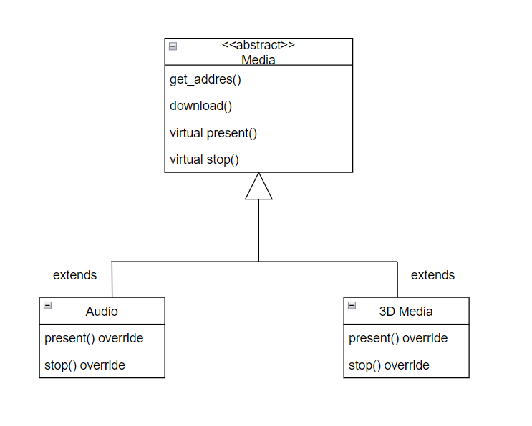
Design case <3> (UML2)
Problem: range of similar actions (but not all) while working with different types of media.
Similar actions: get address by id, download
Different actions: present (display or play), stop presenting
Solution: use template method
Notes:
Лена

Slide 7
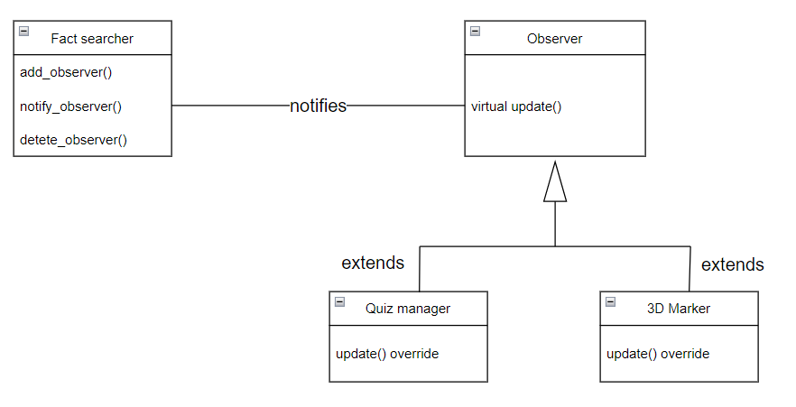
Design case <4> (UML2)
Problem: several classes (quiz, 2D markers) use facts and need to be notified when a new fact is added by fact searcher
Solution: use observer
Notes:
Артём

